Slide 1
Landmarked
1

Slide 2
Sprint 1 Goal
1
Kickstart development on Landmarked Core Functionality and supporting technologies for future development.
Develop an algorithm that will get coordinates for drawing our maps
Design a GUI around our user stories
Configure Mapbox API
Retrieve data from hardware sensors

Slide 3
Core Functionality
1
What did we consider important to Core Functionality and project development?
Design
Algorithm
GUI
MapBox API
More Research
Database
Supporting Technologies

Slide 4
Questions?
1

Slide 5
Product Backlog
1
Develop Algorithm
Initial research into necessary sensor data
Accuracy of sensors
What data do we need to return?
Additional Design Work

Slide 6
Product Backlog (cont)
1
GUI Design to accommodate User Stories, Core Functionality, and possibly scalable to future stretch goals.
Mockups
Bare-bones implementation
User Story verification – Does GUI functionality align with User Stories?

Slide 7
Product Backlog (cont)
1
Design Entity Relationship Diagram for Database
Thorough Investigation of Cloud Database solutions
Design a safe and secure local data storage solution.
Verify Android’s On-Device SQLite capabilities
Determine what kind of data needs to be stored where

Slide 8
Product Backlog (cont)
1
Research into Google’s Android Authentication system
Document and Determine necessary MapBox API calls and capabilities for the team.
Obtain API Key for MapBox.
Develop module to read sensors on Android device

Slide 9
Questions?
1

Slide 10
Problems in the beginning
1
Started building without enough design work
Led to wasted time
Refocus at 1.5-2 weeks into sprint
Shifted focus to focus on core functionality must-haves

Slide 11
UML Design
1
Flexible Design Documents to allow for Agile-style development
Based on User Stories and Core Functionality
High level design overview

Slide 12
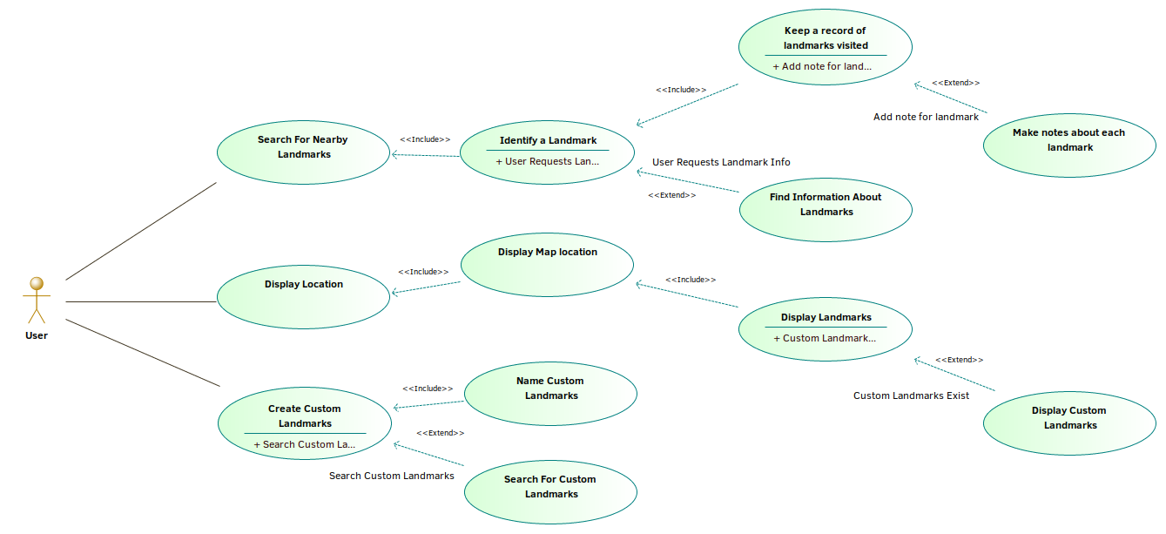
Use Case: General Application
1

Slide 13
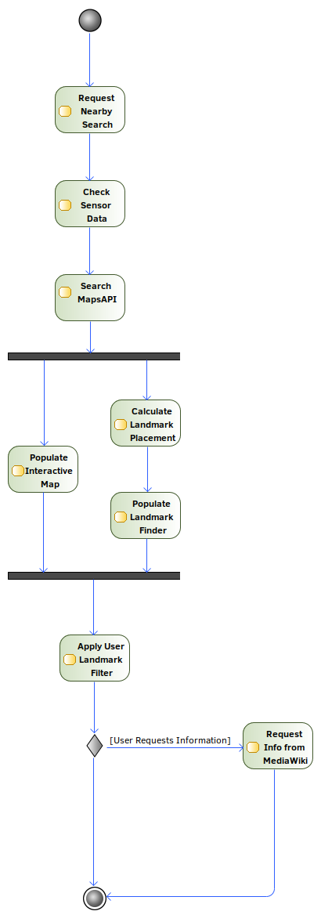
Activity Diagram: Identify Nearby Landmarks
13

Slide 14
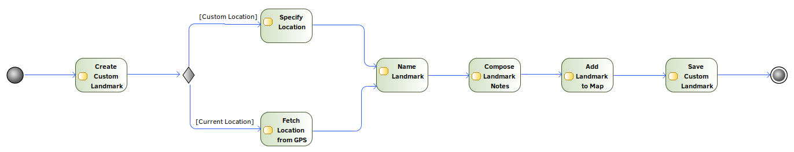
Activity Diagram: Create Custom Landmark
13

Slide 15
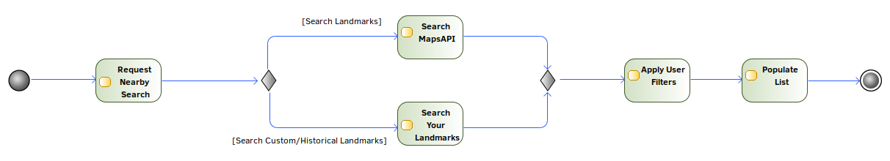
Activity Diagram: Search Landmarks
13

Slide 16
Questions?
13

Slide 17
GUI Design
13
Designed a UML style layout of our app navigation
Emphasis on need vs want
Grab bag of features
Accommodating user stories
Removed areas that weren’t justified by a user story

Slide 18
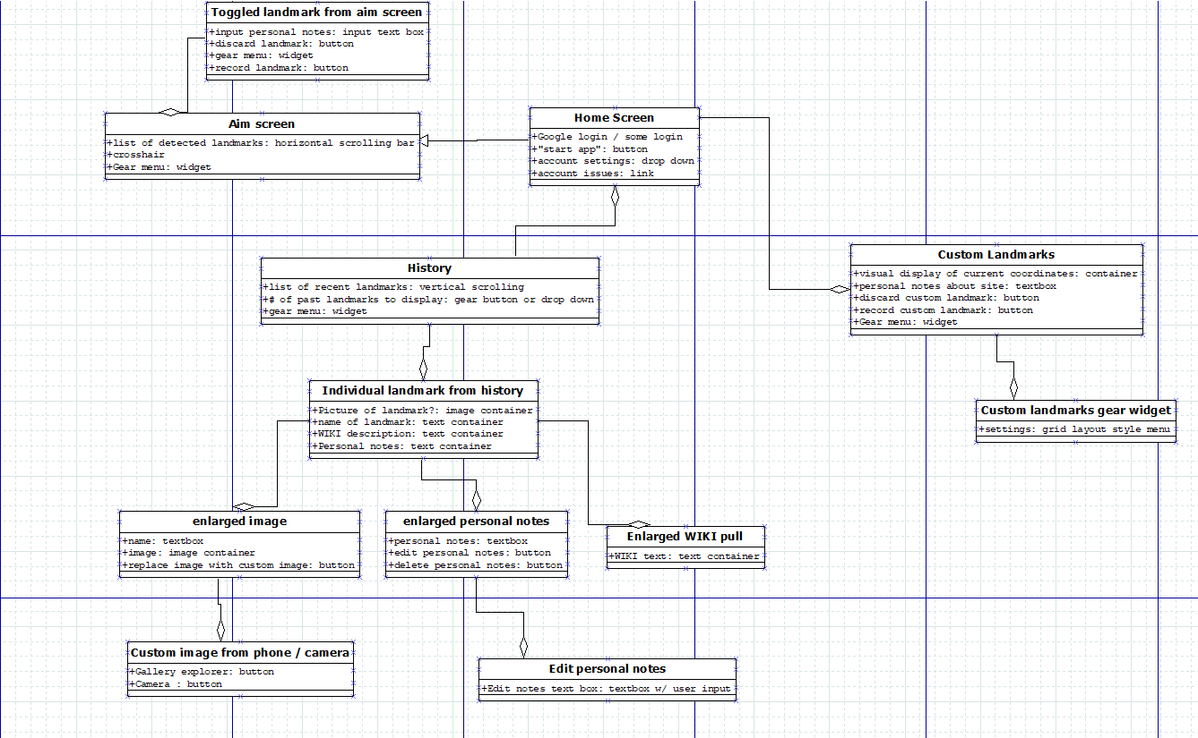
13

Slide 19
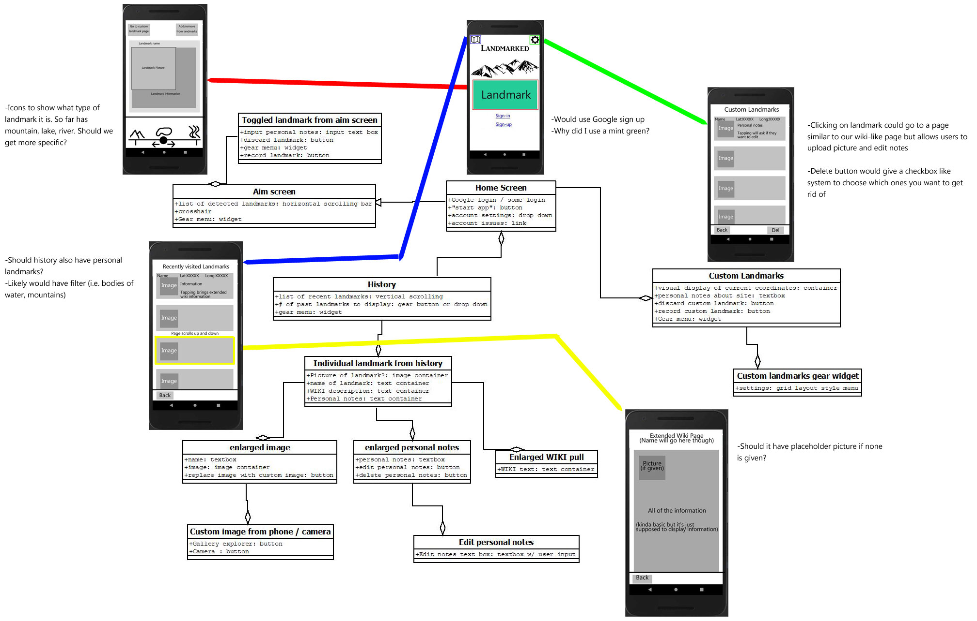
13

Slide 20
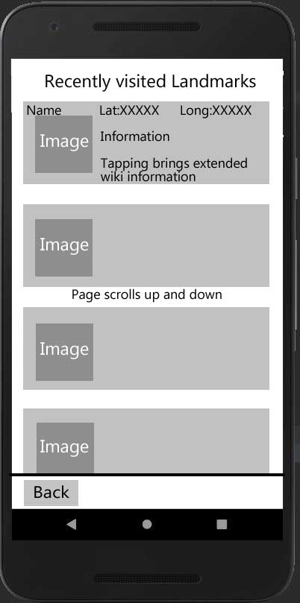
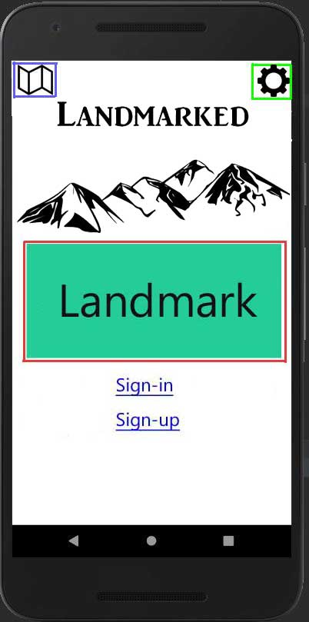
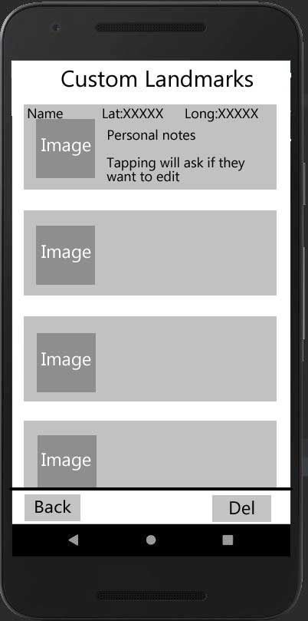
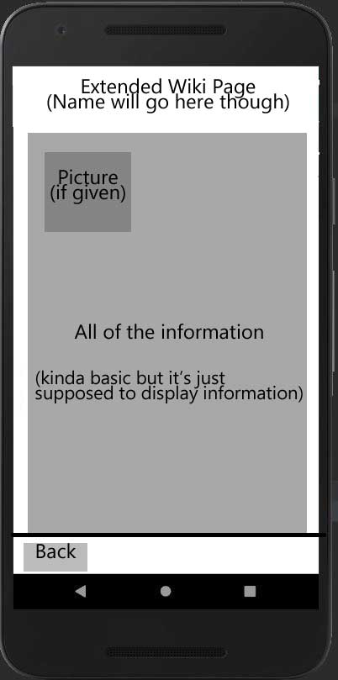
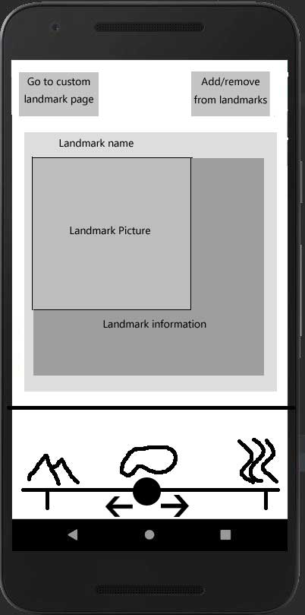
13

Slide 21
GUI Design (cont)
13
Worked with Android Studio to figure out the minor elements of the GUI
Displaying Images
Colors and Opacity
Action Bar
Constraints
Defining an element’s positioning based on other elements
Element spacing
Determined with pixels although there is an add-on that can let you use percentages
App Icon
Minor but has to be done

Slide 22
Questions?
13

Slide 23
Possible Cloud Hosts for Databases
23
Amazon Web Services
Pros
Free trial
Supports multiple database types
Cons
Difficult to learn
Microsoft Azure
Pros
Free trial
Cons
Support issues

Slide 24
Possible Cloud Hosts for Databases cont.
24
Rackspace Cloud
Pros
Supports multiple database types
Cons
Low documentation
Oracle Database Cloud
Pros
Easy maintenance
Secure encryption
Cons
Support issues
SAP Cloud Platform
Pros
Free trial
Cons
Expensive

Slide 25
Chosen Database
24
Azure SQL Database
Free trial gives 250GB of storage on cloud
Shares same codebase with SQL Server
Prefer cloud as users could literally be anywhere

Slide 26
Landmark Data Storage
24
Structure for Landmarks and Custom Landmarks
Local storage:
Internal File Storage
External File Storage
Shared Preferences
Private Databases
Chosen SQLite

Slide 27
Questions?
24

Slide 28
Algorithm
28
Get relevant sensor information
Get elevation
Get location
Get orientation
Find landmarks in orientation
Find Line of Sight (LoS) by numerical method
Find landmarks between location and LoS
Output landmarks to user
Allow user to select landmark
Pull information about landmark
Find distance between current location and landmark

Slide 29
Sensors
28
Accelerometer and Magnetometer
Used to calculate the orientation of the phone
Gives access to:
Azimuth
Pitch
Roll
GPS
Requires explicit user permission
Gives access to:
Latitude
Longitude
Elevation

Slide 30
MapBox API
30
Dove into documentation
Used our acquired key to interact with the API
Implemented drawing a map
Current points are arbitrary, but easily modified to reflect points produced by algorithm
Currently working on:
Refining large map into a rectangular shaped map in direction phone is pointing
Drawing markers for landmarks in refined map
Drawing custom markers (custom landmark locations)
Retrieving location data from refined map

Slide 31
DEMO TIME
30

Slide 32
Questions?
30

Slide 33
Unofficial Sprint
<number>
Sprint over Winter Break
Relatively high aspirations
Scrum Master remains the same until next official sprint.

Slide 34
Unofficial Sprint Goal
<number>
Continue development on core functionality.
Testing & Refinement
Algorithm
Design document
GUI Development
Google Authentification
Database Development
Local
Cloud

Slide 35
Sprint 2 Goal
<number>
Refinement of existing development on core functionality
Add Creation of Custom Landmarks
Add the ability to associate personal notes to a landmark
Start working on stretch goals, if time permits
Associating Photos with Landmarks
Landmark information through MediaWiki API

Slide 36
Questions?
<number>

